Slide 1
Economic surplus analysis
Summary of inputs received

Slide 2
Feedback by MESC members
Background – In July 2026, ACER shared the methodological annex with MESC asking for feedback and suggestions for improvement. ACER received five inputs, i.e. ETE, Eurelectric, ENTSO-E, Europex, All NEMO Committee.
Summary – the feedback received can be summarised as follows:
  Stakeholders welcomed the initiative – MESC members appreciated their involvement and the transparency demonstrated by ACER. Stakeholders also welcomed the prospect of further involvement and expressed a willingness to participate actively.
  Technical comments - Highlighted the methodological limitations of the study, including both major and minor comments.
  Other considerations not directly related to methodologies – Other points were raised, for example on the project prioritisation and the comparability of results, or the attribution of “unrealised welfare” to project delays.
  Different reactions – Overall, stakeholders welcome the initiative to carry out an ad-hoc analysis assessing the socio-economic welfare generated by market integration projects. However, reactions to the final publication vary significantly, ranging from requests to postpone its release to a favourable view of its publication.

Slide 3
Bringing onboard the inputs received
Following the inputs received by MESC, ACER made the following changes and improvements to the methodological annex (reflected also in the analysis presented in the Market Monitoring Report):
  Clarifications on the criteria considered to select the 13 market integration projects* are added in the introduction – the selection was based on (1) the technical feasibility of producing a meaningful estimate; (2) the availability of existing assessments; (3) their importance to completing the internal electricity market.
  Additional section on the use of congestion income as rescaling factor for economic surplus was added – ACER performed an additional analysis on the use of congestion income as re-scaling factor for economic surplus, with a case study on ITN CCR.
  “ITN flow-based in SDAC (Central Europe CCR)” project was removed from the list of quantitatively assessed projects – Despite the improvements introduced by the new analysis on congestion income as re-scaling factor for economic surplus, ACER acknowledges that some limitations remained.
  Improved wording and greater accuracy - The concept of “welfare losses” has been re-worded to “unrealised economic surplus”; while “socio-economic welfare” has been re-worded to “economic surplus”, as it is more precise and correct.
  Several minor comments are taken onboard
(*) List of market integration projects with quantitative assessment: Long-term flow-based (Core CCR), Nordic flow-based in SDAC, Core flow-based in SDAC, TSOs accession to IGCC, Market-based allocation (Nordic CCR), 70% requirement (estimate for Core CCR only), TSOs accession to MARI, TSOs accession to PICASSO, ROSC-RDCT (Central Europe CCR), Integration of Energy Community in SDAC , Flow-based allocation in IDAs (Core CCR), Bidding zone review, Co-optimisation.

Slide 4
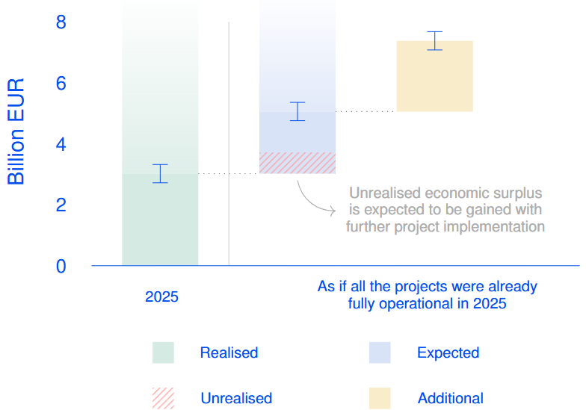
How will the analysis look like?
What does the analysis include? – (1) a section in the annual Market Monitoring Report, and (2) a dedicated annex.
What are the projects considered? – A selection of 13 projects were considered.
How is the economic surplus displayed? – to present the economic surplus estimates accurately, 4 categories are used:
realised economic surplus - (fully or partially) implemented projects;
unrealised economic surplus - (fully or partially) delayed projects;
expected economic surplus - implementation of currently delayed projects (full or partially) or projects that are scheduled for implementation in the future;
additional economic surplus - as if a list of projects* with uncertain or conditional implementation had already been implemented.
Economic surplus stemming from a selection of market integration projects – 2025 (billion EUR).
Source: ACER calculation based on multiple sources (see methodological annex)
Faded areas indicate the economic surplus generated by projects whose surplus was not quantified in this assessment**, suggesting that the overall economic surplus from market integration is substantially greater than the estimates presented in this figure.
(*) Bidding zone review and co-optimisation
(**) Non-exhaustive list of additional market integration projects (without quantitative assessment): Italy North flow-based in SDAC (Central Europe CCR), advanced hybrid coupling for day-ahead (Core capacity calculation region), coordinated validation (Core CCR), 15-min MTU (i.e. market time unit), IDCZGCT 30mins (i.e. intraday cross-zonal gate closure time), Pan-EU intraday auctions, flow-based allocation in continuous intraday market, flow-based allocation in balancing energy platforms, regional sizing of reserve capacity, regional procurement of balancing capacity.

Slide 5
Looking ahead
Objective: ACER plans to continue this exercise in the future, with the aim of expanding the list of quantitatively assessed projects and, where possible, further refining the methodologies.
Next steps: ACER would like to expand the analysis including, for example, economic surplus assessments for “Italy North flow-based in SDAC (Central Europe CCR)” and “Advanced hybrid coupling for day-ahead (Core CCR)”.
Proposals for already assessed projects whose estimates can be improved, as well as additional projects that should be considered, are welcome.
What inputs are needed: previously performed parallel runs* provided a useful contribution to this 2026 assessment. To ensure precise estimates and robust methodologies, ACER stresses the need to perform parallel runs and share the resulting data and outcome.
(*) for the implementation of day-ahead flow-based in the Core and Nordic CCRs.

